Slide 1

Unit – III
Software Project Management

Slide 2
3.1 Responsibility of Software Project Manager
Responsible for accomplishing the stated project objectives.
The job responsibility → Planning to Deployment
Bridging gap between the production team and client.
□
Manage constraints of project management triangle which are Cost, Time, Scope and Quality.
General activities: like project proposal writing, project cost estimation, scheduling, project staffing, software process tailoring, project monitoring and control, software configuration management, risk management, interfacing with clients, managerial report writing and presentations, etc.

Slide 3
Take the overall
success.
Above activities
responsibility of project
mainly classified in →
project planning, monitoring and controlling.
Risk management.
Time and cost estimation.

Slide 4
Skills needed for software project manager
Project manager take the decision that directly affects the benefits of the projects.
He sets up development milestones and entry or exit criteria.
The skills required in project manager to manage the project, are:
Must have theoretical-Technical knowledge.
A good decision making capabilities.
He should be client representative.
Should have management skill.
Focuses on risk management.
He should have team leadership skill.
He should have the experience in the related area.

Slide 5
Monitoring and scheduling capability
Evaluating performance of each milestone
Some skills like tracking and controlling the progress of the project, customer interaction, managerial presentations, and team building are acquired through experience.

Slide 6
3.2 Metrics for project size estimation

Slide 7
Project Planning Activities
Estimating the following attributes of the project:
Project size: What will be problem complexity in terms of the effort and time required to develop the product?
Cost: How much is it going to cost to develop the project?
Duration: How long is it going to take to complete development?
Effort: How much effort would be required?
The effectiveness of the subsequent planning activities is based on the accuracy of these estimations.

Slide 8
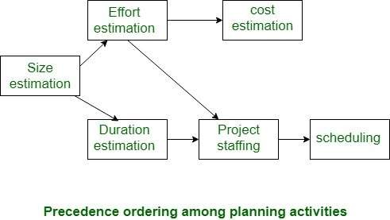
Project Planning

Slide 9
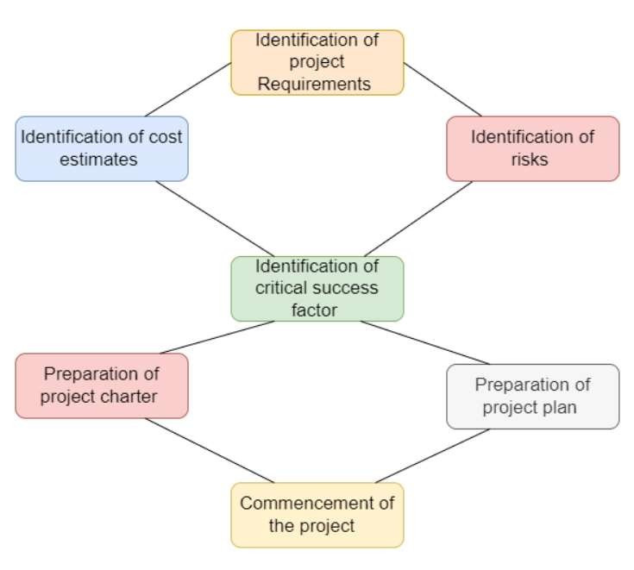
Project Planning

Slide 10
Metrics for project size estimation
The project size is a measure of the problem complexity in terms of the effort and time required to develop the product.
There are several metrics to measure problem size. Each of them has its own advantages and disadvantages.
Two important metrics to estimate size:
Lines of code (LOC)
Function point

Slide 11
Lines of Code (LOC)
Simplest and most widely used metric.
The project size is estimated by counting the number of source instructions/lines in the developed program.
Comments and blank lines should not be counted.
To estimate LOC, project manager divides the problem into modules and sub modules, until leaf level modules can be estimated.

Slide 12
Line of Code (LOC)
Disadvantage:
Size can vary with coding style.
Focuses on coding activity alone.
Correlates poorly with quality code.
and efficiency of
Penalizes higher level programming languages, code reuse, etc.
Measures lexical/textual complexity only.
□ does not address the issues of structural or logical complexity.
Difficult to estimate LOC from problem description.

Slide 13
Function Point Metric (FP)
It was first proposed by Albrecht in 1979 and internationally approve modified model in 1983.
This metric overcomes many of the shortcomings of the LOC metric.
Function point metrics, measure functionality from the users’ point of view.
FP is directly dependent on the number of different functions or features it supports.

Slide 14
Function Point Metric (FP)
A software supporting many features or functions should have larger in size.
FP considers five different characteristics of the product to calculate the size. The function point (FP) of given software is the weighted sum of these five items, and it will give Unadjusted Function Point (UFP).

Slide 15
Function Point Metric (FP)
Once the computed,
unadjusted
function point (UFP) is
the Technical Complexity Factor
(TCF) is computed next.
TCF refines the UFP by considering 14 factors which assigns 0 (no influence) to 5 (strong influence). These numbers are summed and yielding DI (Degree of Influence).
Now TCF is computed as
TCF = ( 0.65 + 0.01 * DI )
As DI can vary from 0 to 70, TCF can vary from
0.65 to 1.35.
Finally: FP = UFP * TCF
15

Slide 16
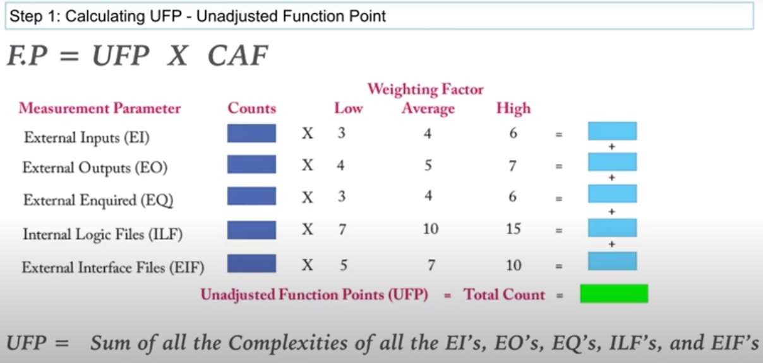
Step 1

Slide 17
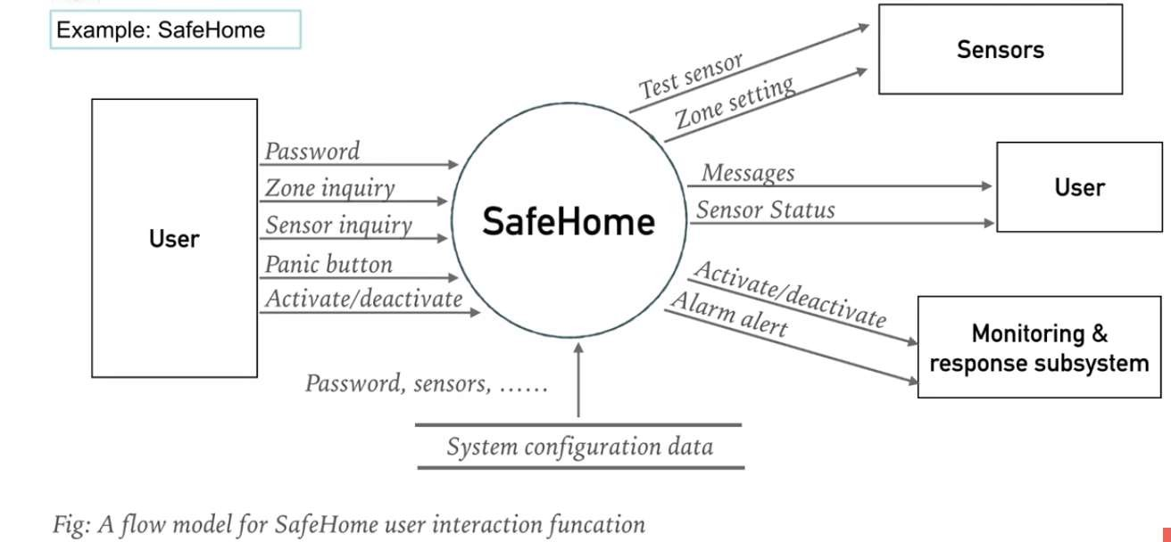

Slide 18
number of user inputs - password, panic button, and activate/deactivate
number of user outputs - messages and sensor status
number of user inquiries - zone inquiry and sensor inquiry
number of files - system configuration file
number of external interfaces - test sensor, zone setting, activate/deactivate, and alarm alert

Slide 19

















Step \: ¢alculzting UFP
\¥ciyllting I"artor
A›'cr1gc
l?Ica.xurcmcnt l'zramctcr
finunt,x
Ln\v
I'ligh
1 4
X 3
Li‹r*f0‹pn(E0)
ExtcrnJ Enquired(E@
x
i
&RrnJ fntcrfarc 5i!cs(EIF)

Slide 20
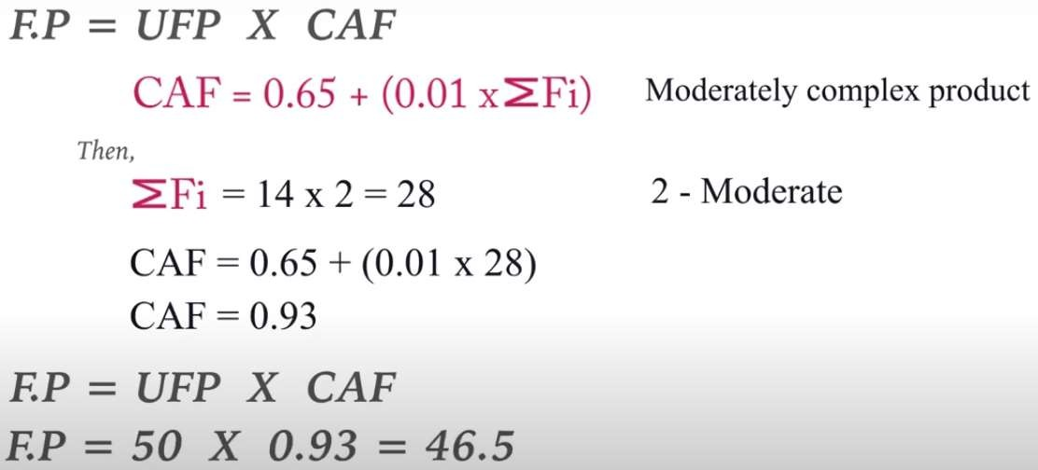

Slide 21
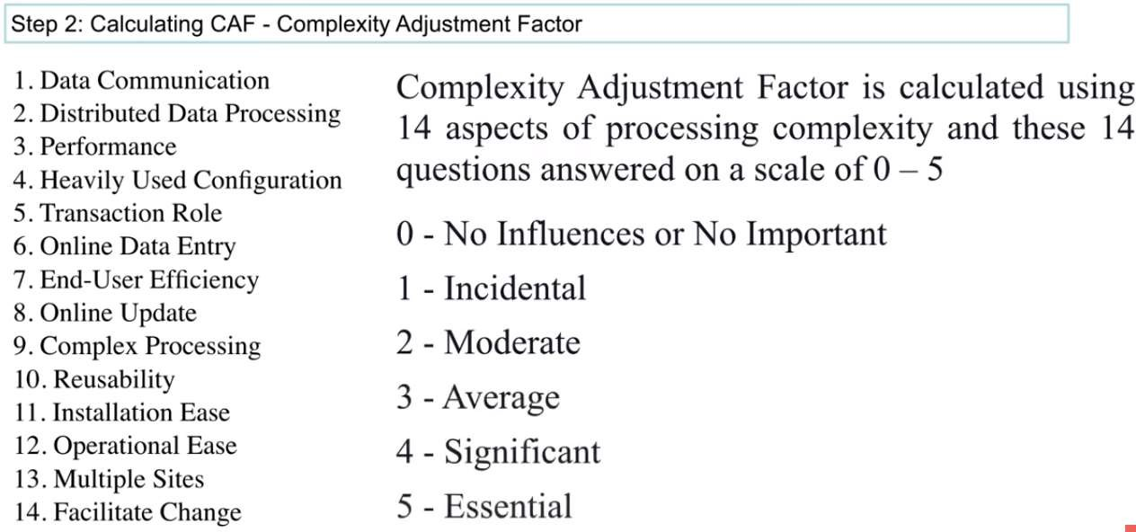
Step 2 CAF

Slide 22
Function Point Metric (FP)
Advantages:
More accurate than LOC
We can measure from specification
Disadvantages:
It ignores quality of output.
It is fully oriented to traditional data processing system.
Major shortcoming: it doesn’t take algorithmic complexity into account.
To overcome this problem, an extension of the function point metric called feature point metric is proposed, which incorporates an extra parameter for algorithm complexity.
Not applicable universally, not good for real time software.

Slide 23
3.3 Project Estimation Techniques
The important project parameters that are estimated include: project size, effort required to develop the software, project duration, and cost.
There are three main categories of project estimation techniques:
Empirical estimation techniques
Heuristic techniques 3.Analytical estimation techniques
 Empirical estimation techniques
It is based on making an educated guess of the project parameters.
The project managers use their past experiences to
make guess.
23

Slide 24
Project Estimation Techniques
I.Expert judgment
□ Process:
Identify Experts: Select individuals with relevant expertise.
Consultation: Engage in discussions or interviews to gather their insights on cost estimates.
Synthesis: Combine expert inputs to form a coherent estimate.

Slide 25
Project Estimation Techniques
I.Expert judgment
Expert makes an educated guess of the problem size after analyzing the problem in detail.
Expert estimates the costs of different modules (or units) then combined them for overall estimation.
But in some situation, an expert may not have knowledge of all aspects of project or he may overlook some factors.

Slide 26
Project Estimation Techniques
So, the
chance of human error or
individual bias should be there.
To solve the
above
problem
→a more
refined form of expert
judgment is the
estimation made by group of experts. It should minimize the factors of above problem.
Even after this, chance of biasing is there.

Slide 27
Project Estimation Techniques
I.Expert judgment
□ Advantages:
Quick Implementation: Can be conducted rapidly without extensive processes.
Flexibility: Adaptable and stages.
Disadvantages:
to various project contexts
Subjectivity: Estimates may be influenced by individual biases or limited perspectives.
Lack of Anonymity: Experts may be influenced by group dynamics or dominant opinions.

Slide 28
Project Estimation Techniques
II.Delphi cost estimation
It provides solution to the shortcomings of the expert judgment approach.
Delphi estimation is carried out by a team having a group of experts (estimators) and a coordinator.
In it, the coordinator provides each estimator with a copy of the software requirements specification (SRS) document and a form for recording his cost estimate.
Estimators complete their anonymously (unidentified) coordinator.
individual estimates and submit to the

Slide 29
Project Estimation Techniques
The estimators mention any unusual characteristic of the product/project in their estimation report.
The coordinator prepares summary and
allocate to estimators.
Based on this summary, estimate.
the estimators re-
This process is iterated for several rounds.
Discussion among the estimators is not allowed
during the entire estimation process.
After the completion of several iterations, coordinators prepares the final estimate.

Slide 30
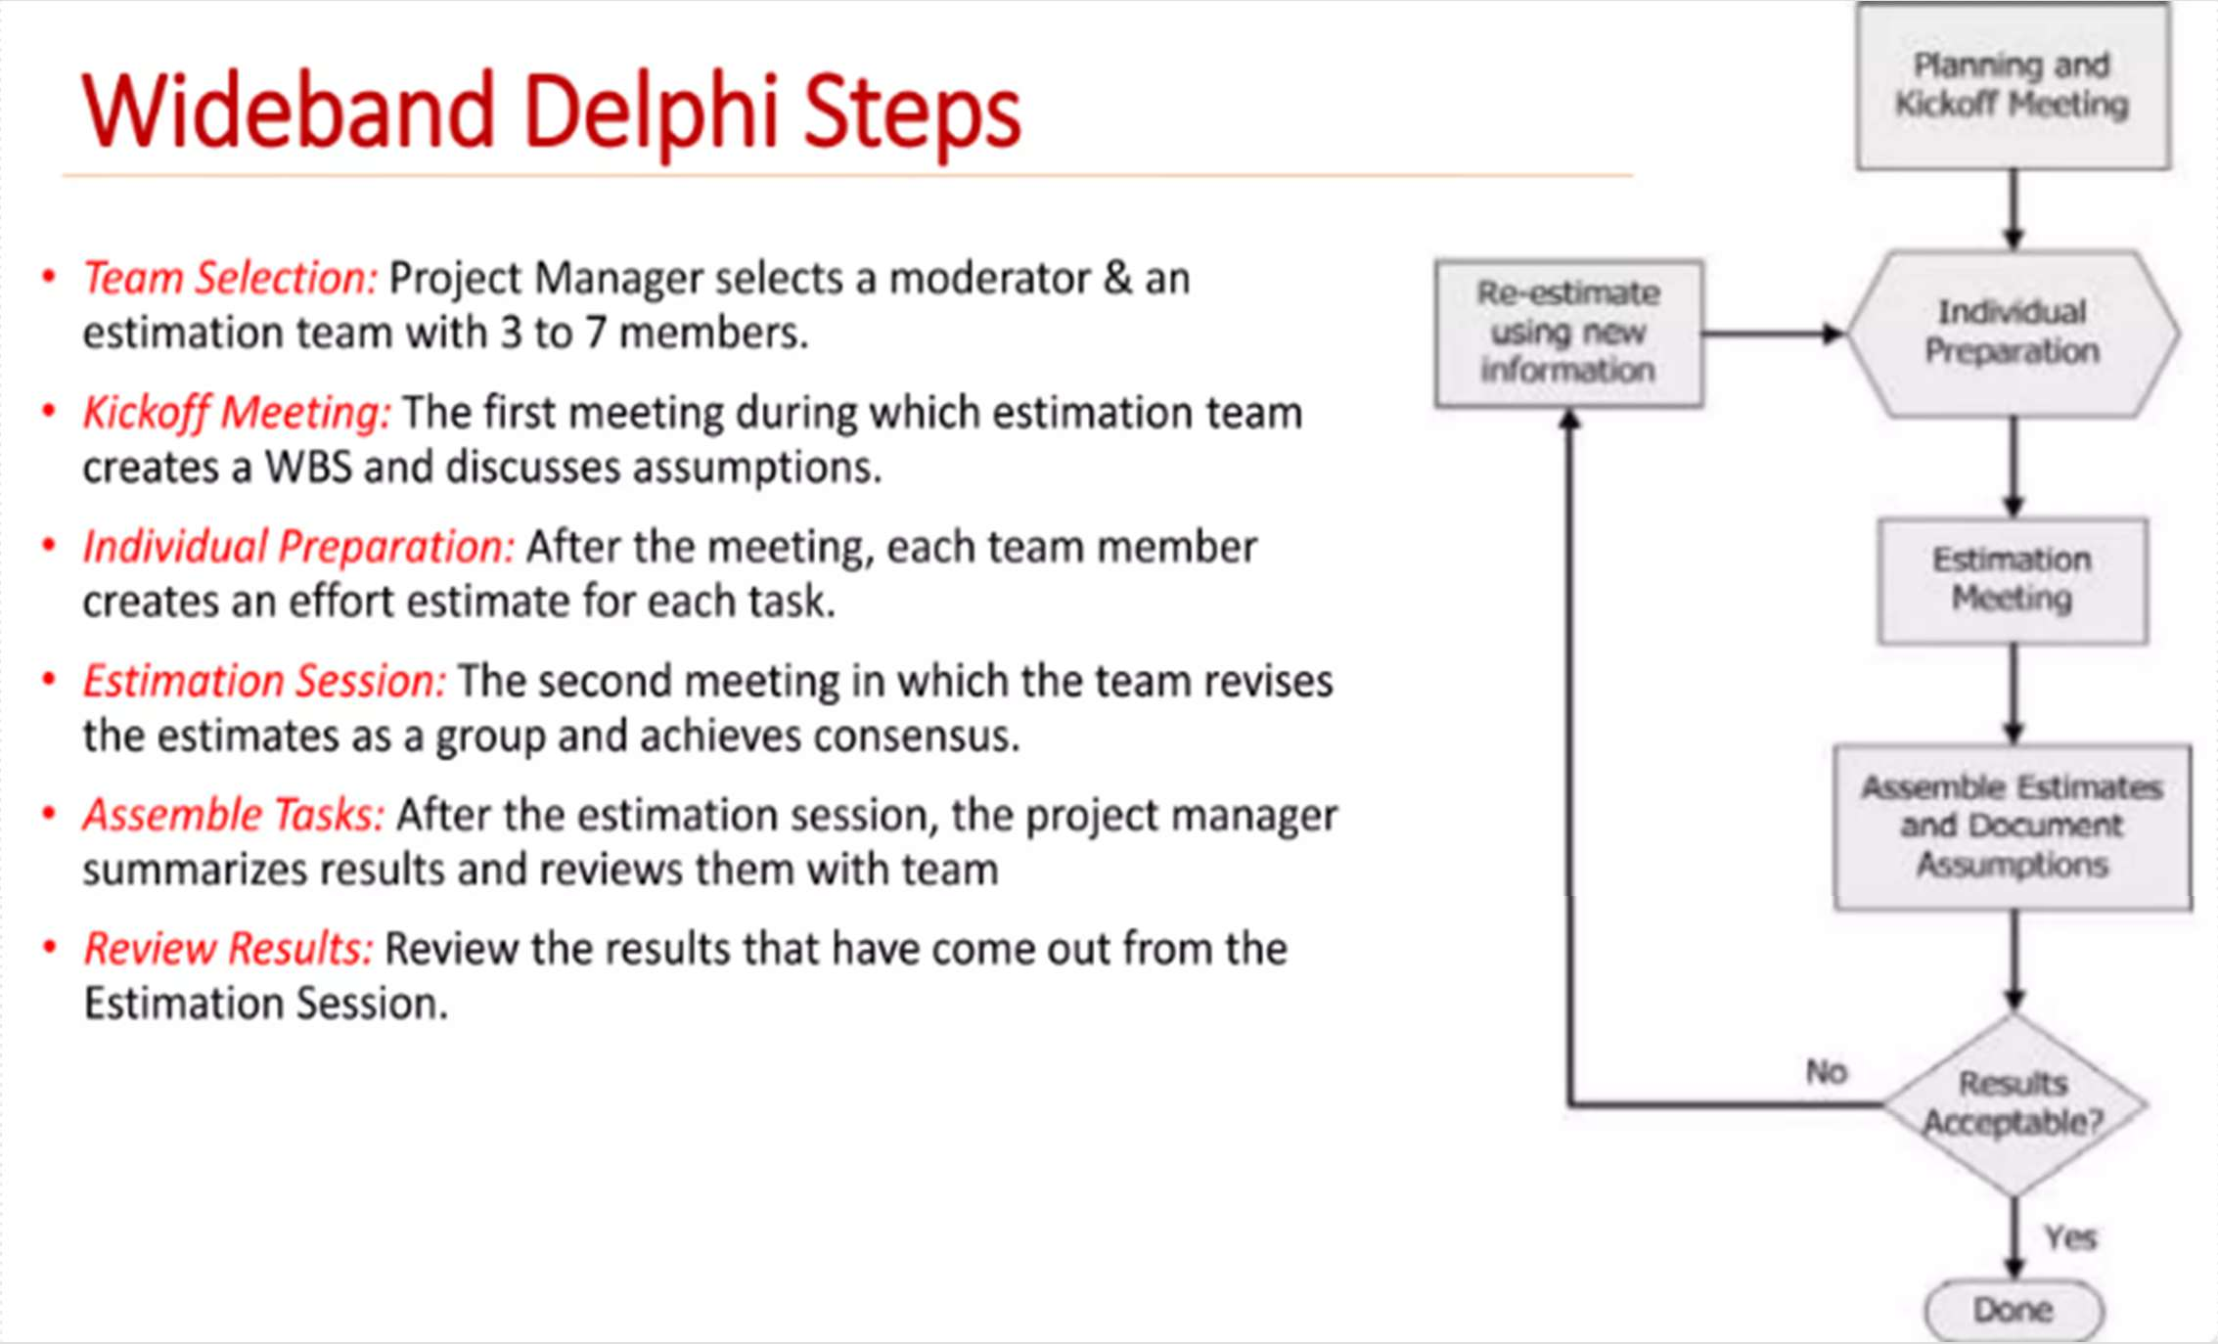
Project Estimation Techniques

Slide 31
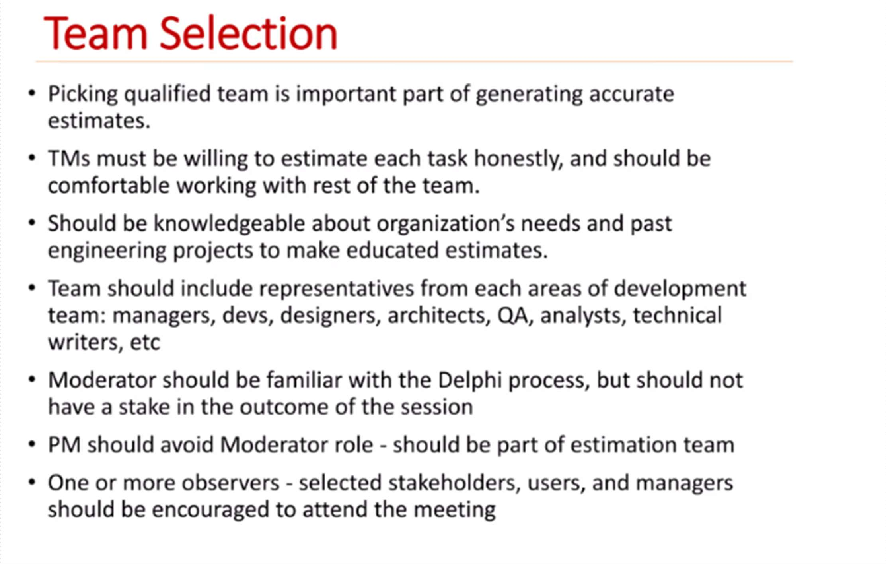
Project Estimation Techniques

Slide 32
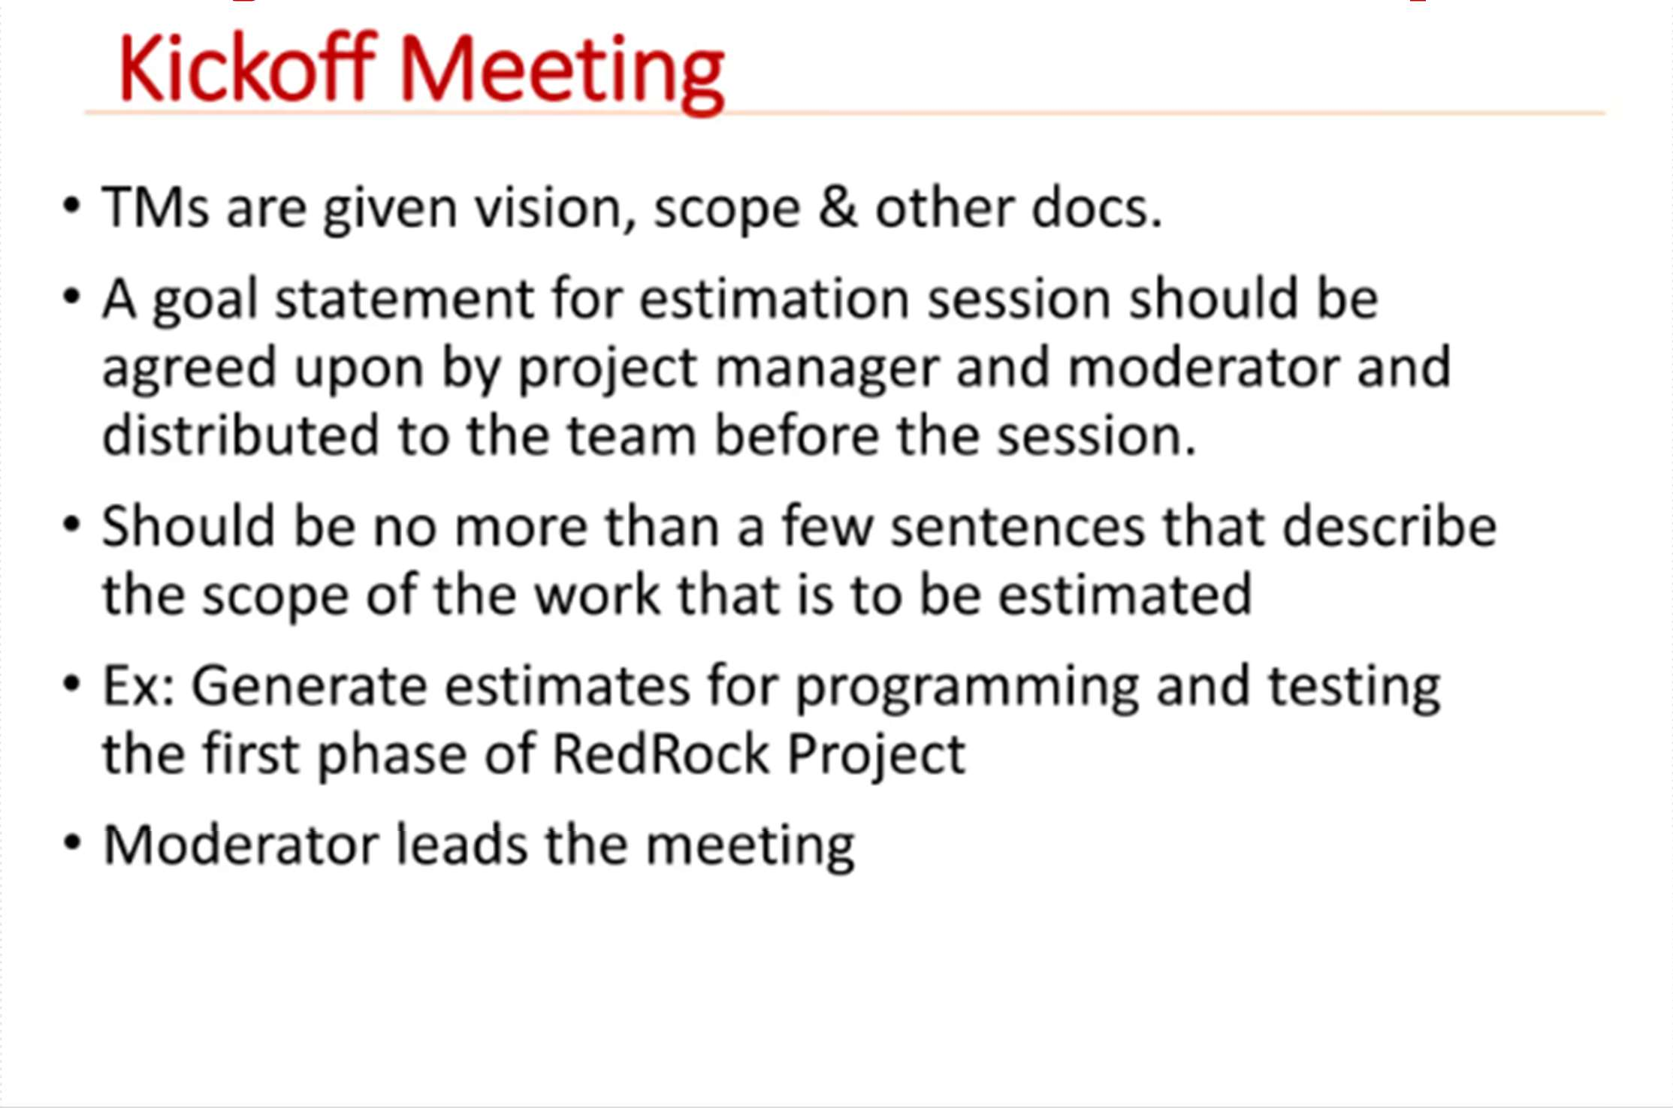
Project Estimation Techniques

Slide 33
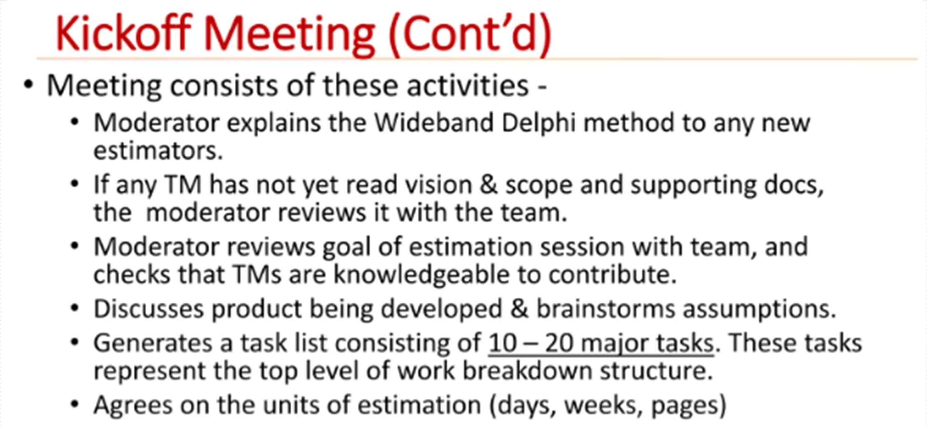
Project Estimation Techniques

Slide 34
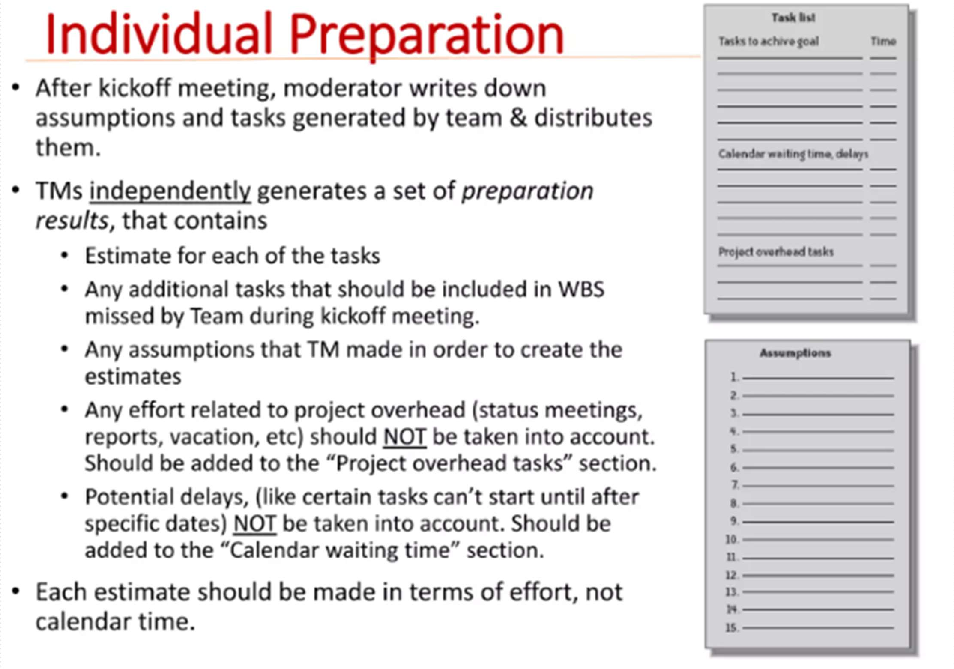
Project Estimation Techniques

Slide 35
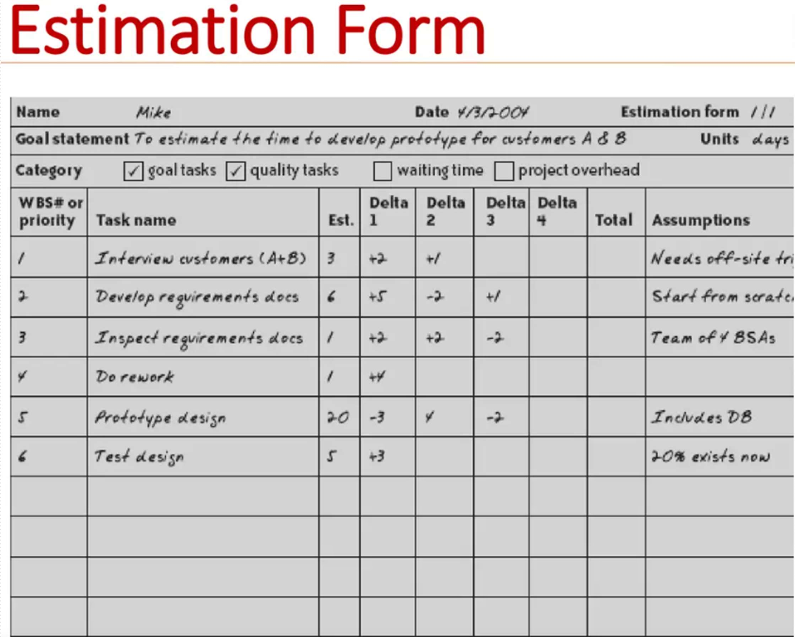

Slide 36
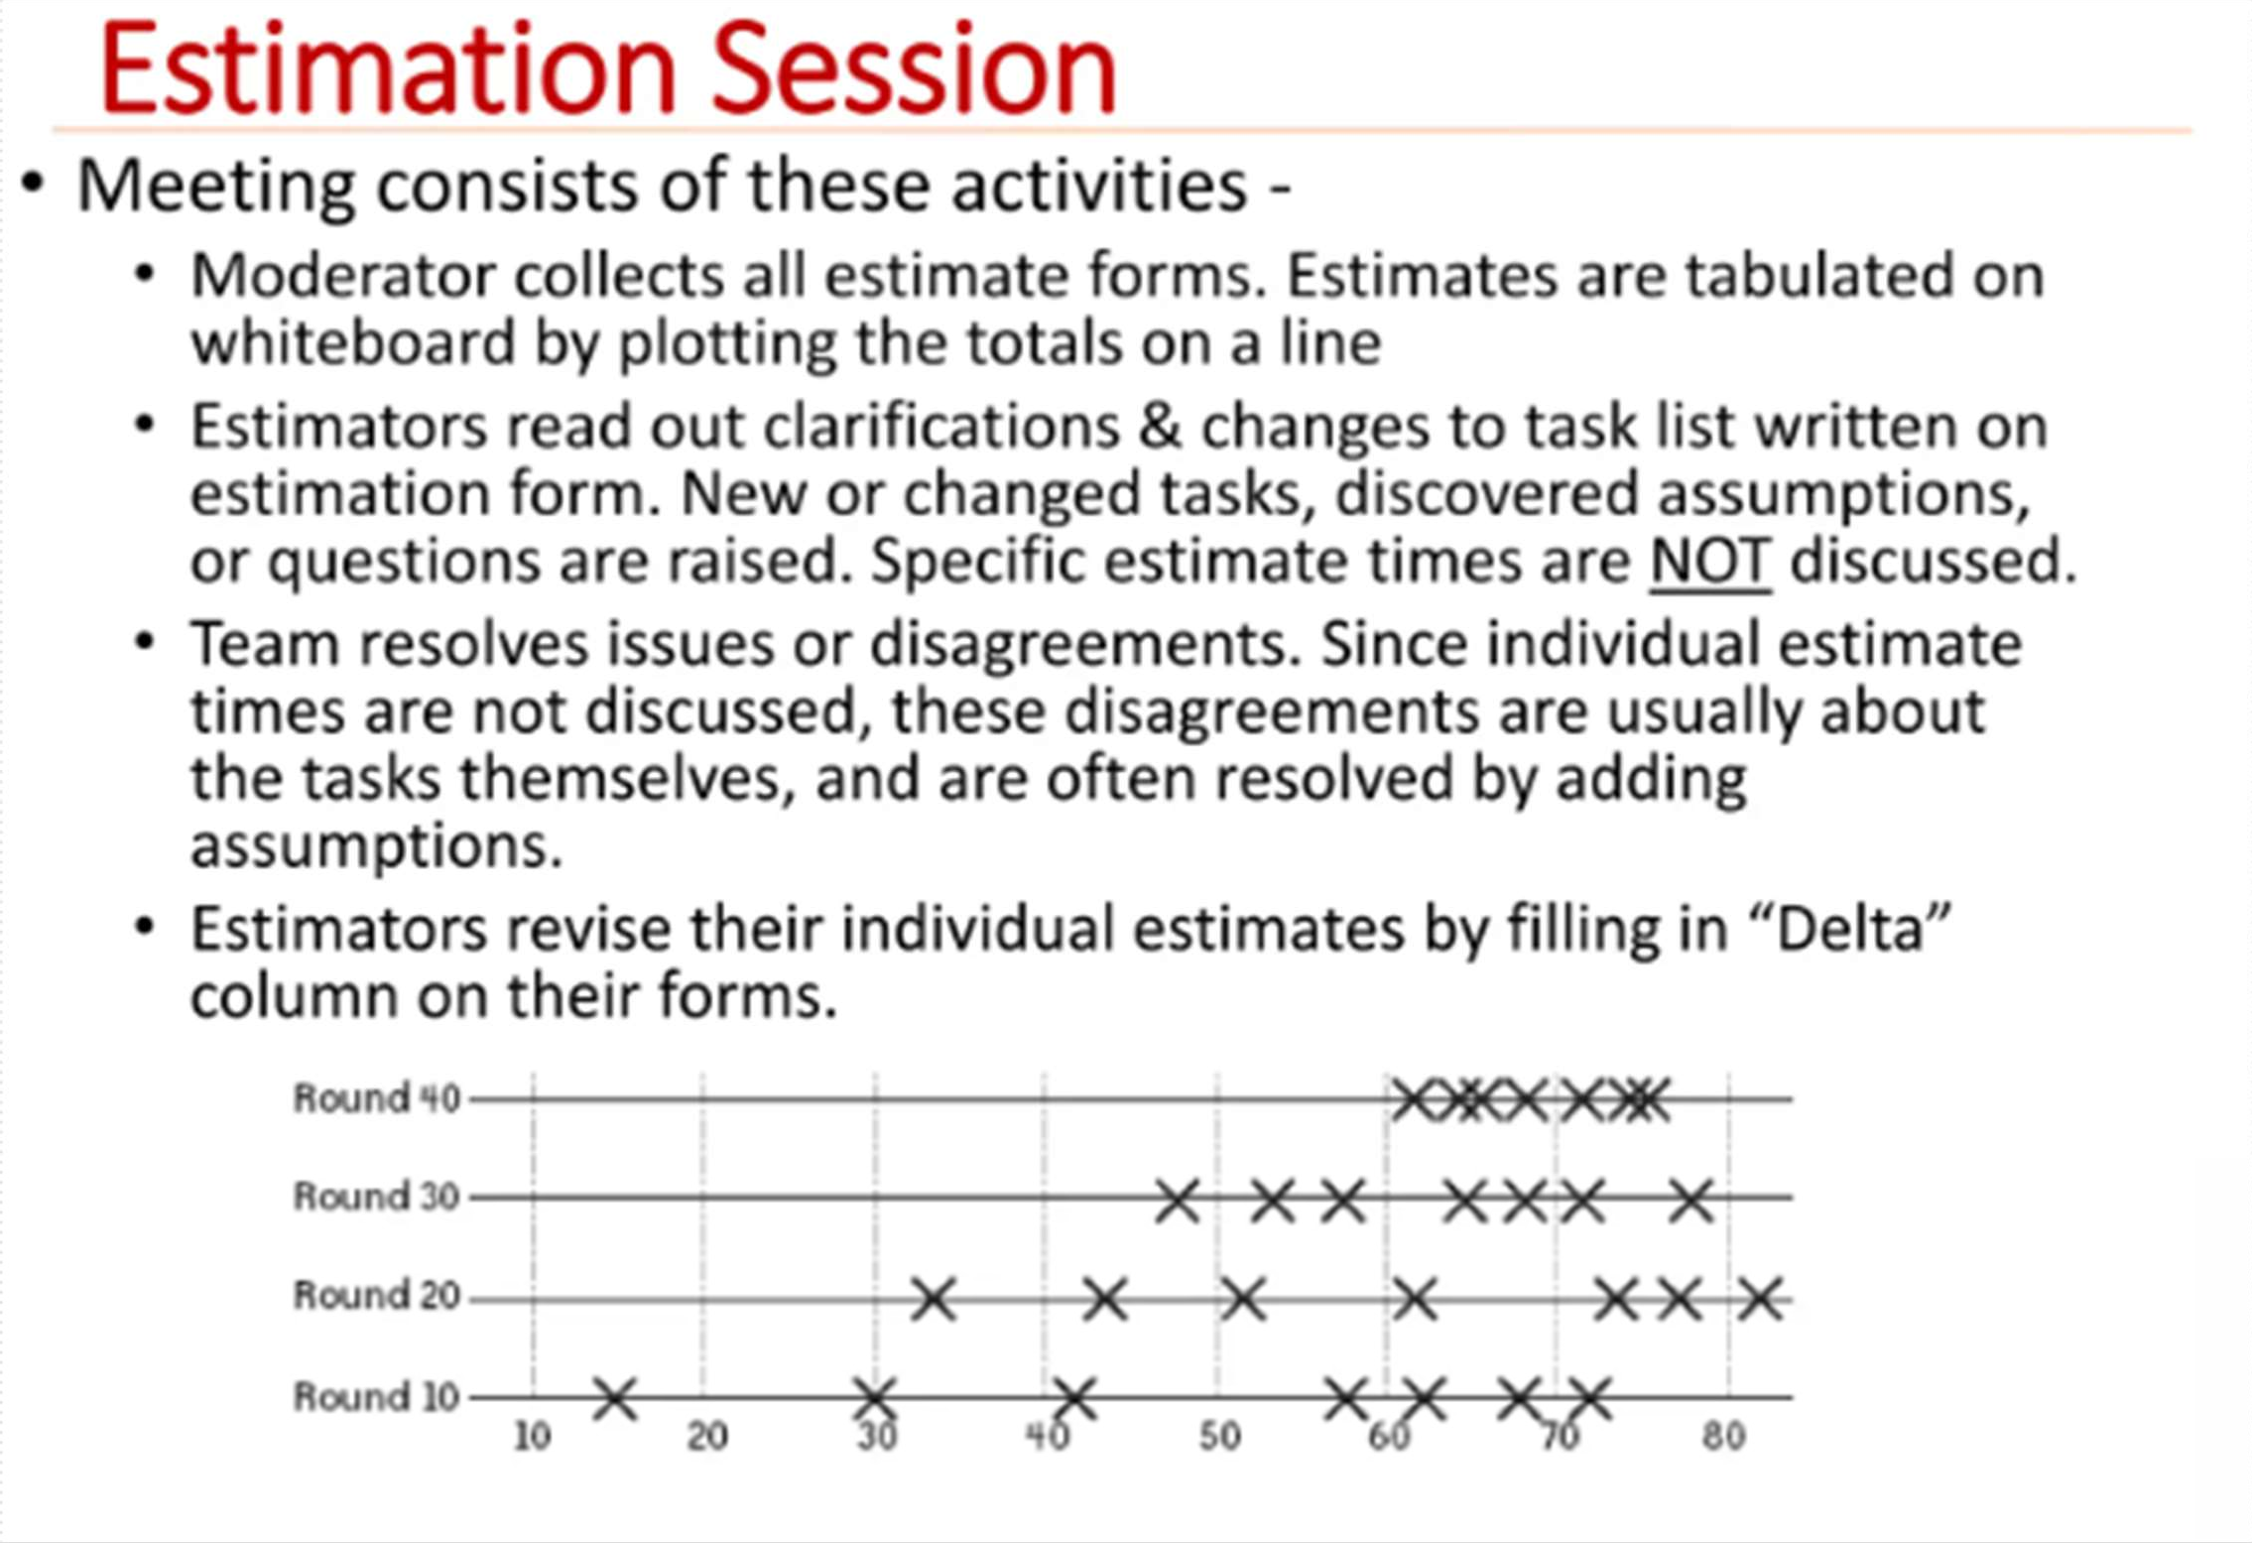

Slide 37
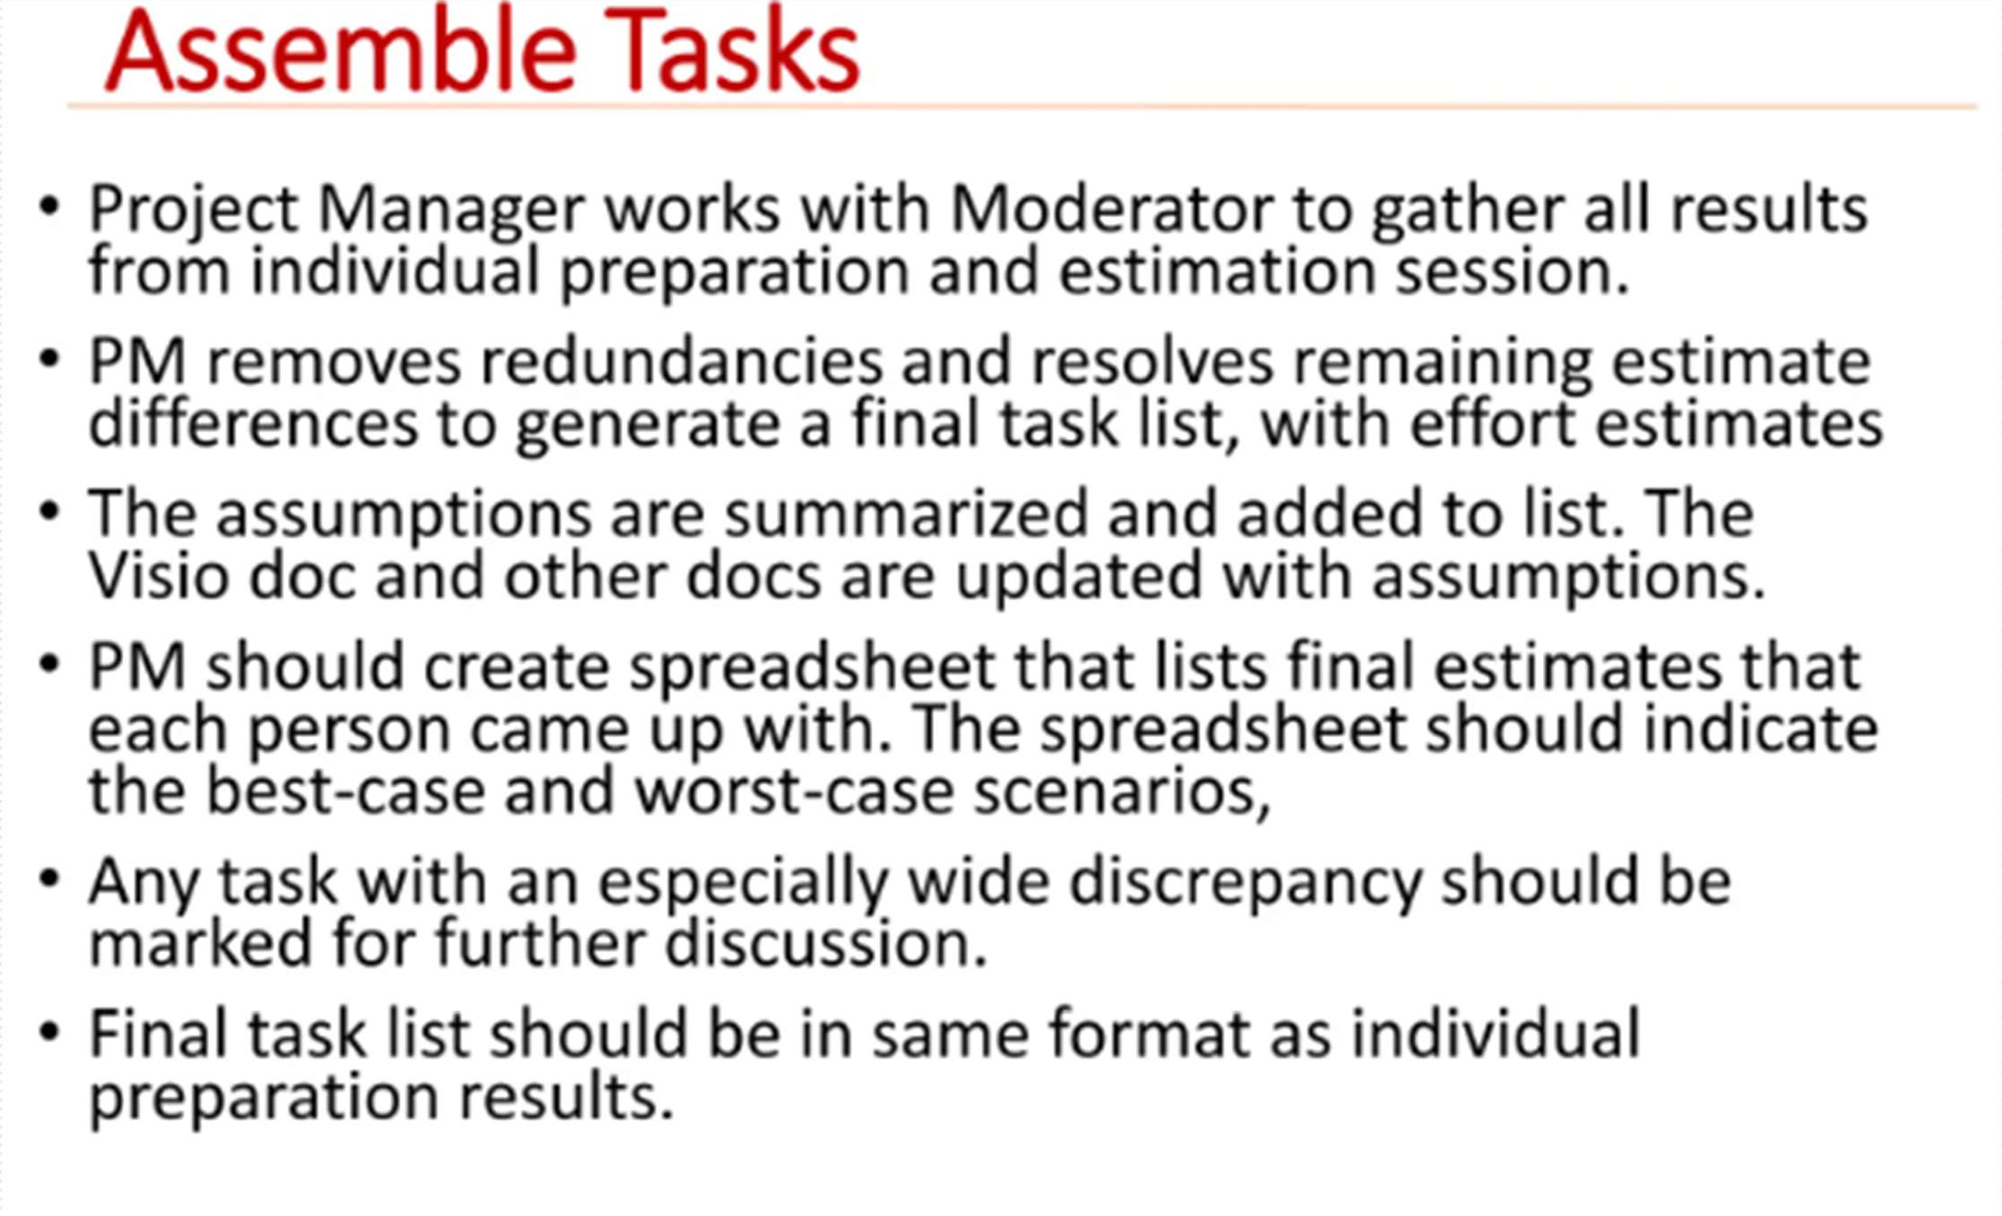

Slide 38
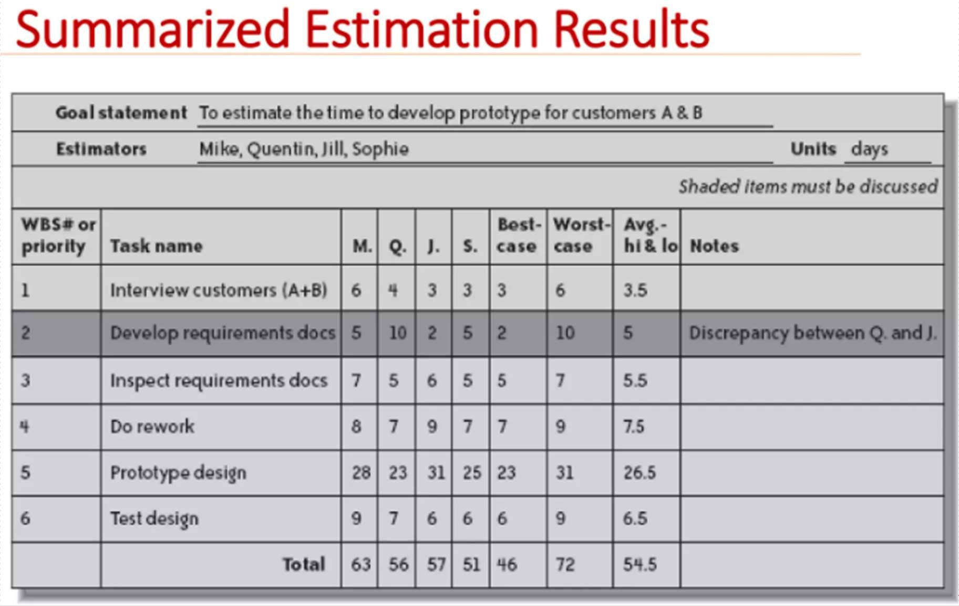
Project Estimation Techniques

Slide 39
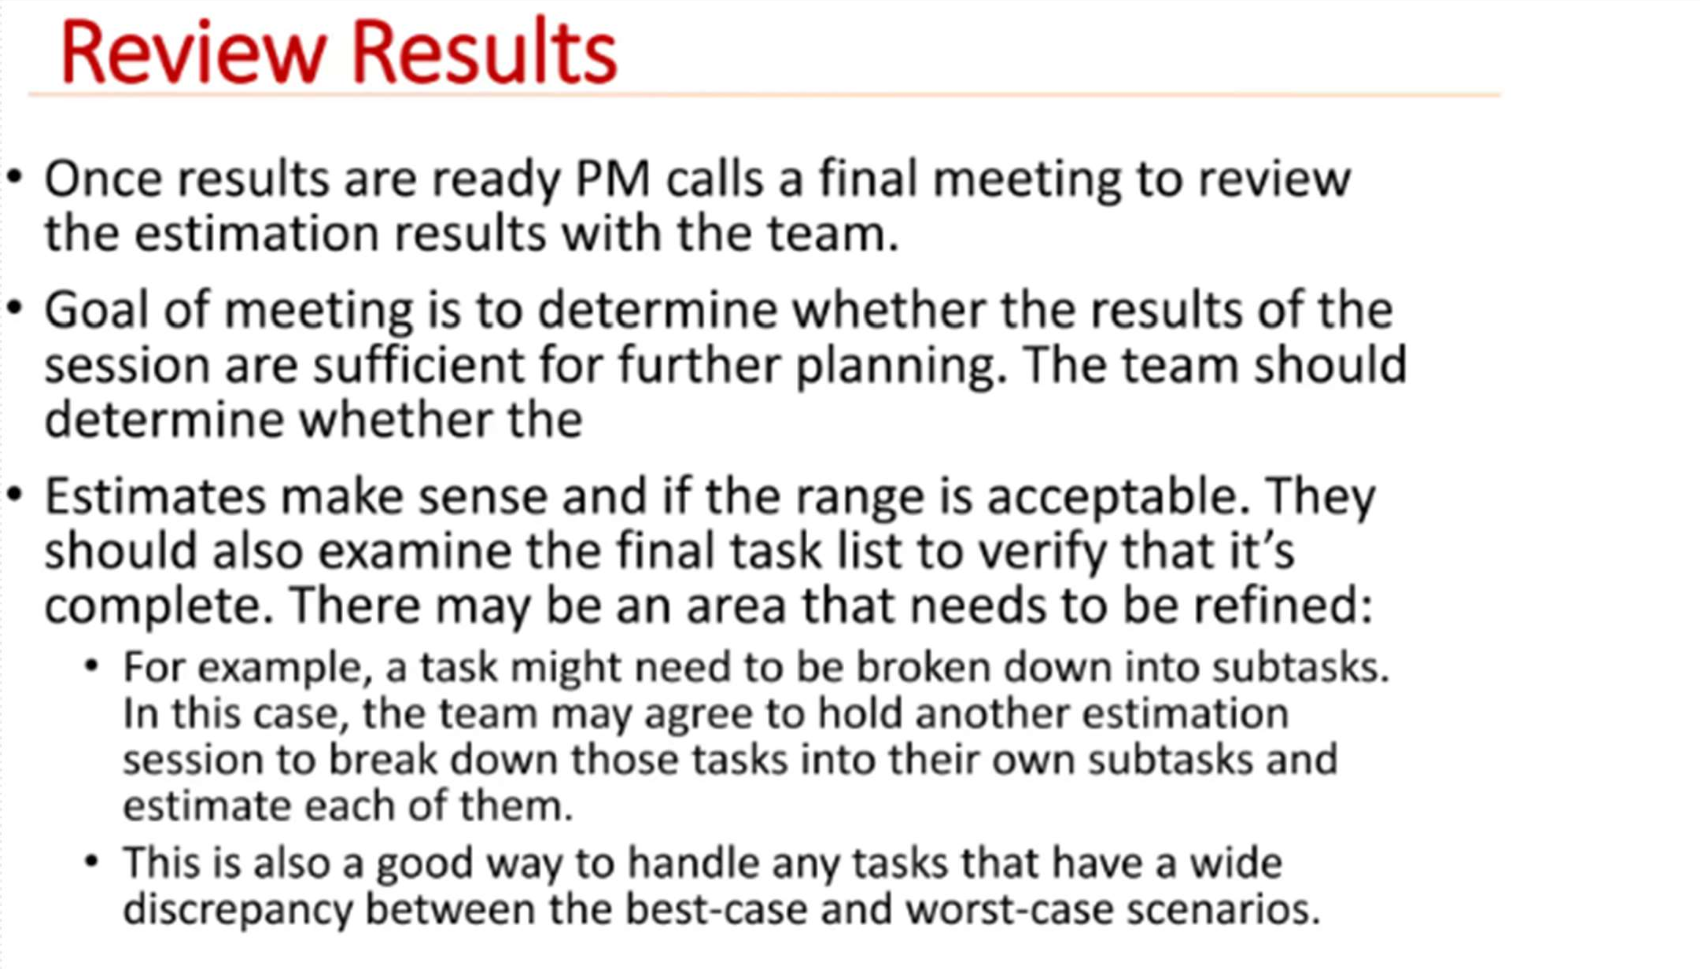
Project Estimation Techniques

Slide 40
Project Estimation Techniques
Pros of Delphi Cost Estimation
Reduces Bias – Since experts provide anonymous estimates, there’s less influence from dominant personalities or organizational politics.
Encourages Expert Input – Uses the knowledge of multiple experts, increasing the accuracy of estimates.
Iterative Refinement – Multiple rounds of estimation allow refinement based on feedback, leading to better accuracy.
Applicable to Complex Projects – Works well for projects with high uncertainty, where historical data is limited.
Encourages Consensus – The process naturally drives experts
toward agreement, improving reliability.

Slide 41
Project Estimation Techniques
Cons of Delphi Cost Estimation
Time-Consuming – Multiple rounds of discussion and revision can take a long time.
Resource-Intensive – Requires participation from multiple experts, which can be costly.
Dependence on Expert Availability – Accuracy depends on the
knowledge and experience of selected experts.
Lack of Quantitative Rigor – The method relies on expert judgment rather than strict mathematical models, which can lead to subjectivity.
Difficulty in Handling Large-Scale Estimates – Managing many experts and rounds of estimation can become complicated for very large projects.

Slide 42
Heuristic estimation techniques
Mathematical techniques are used in this techniques.
Independent and dependent variables.
Static single variable model:
A single variable estimation model takes the following form:
Estimated Parameter = c1 * e^{d1}
Example: basic COCOMO model.
Static multi variable model:
The multivariable cost estimation model takes the following form:
Estimated Resource = c1*e1^{d1} + c2*e2^{d2} + ...
It gives more accurate estimation compare to single variable model.
Example: intermediate COCOMO model.
42

Slide 43
Heuristic estimation techniques
Boehm classified a software into one of the categories based on the development complexity:
Organic
Semi detached
Embedded
following
three
Organic
Small group of team.
Develop well understood application programs and having experienced developers.
Little or no innovation.
Project size should be 2-50 KLOC.
For example data processing programs, payroll, inventory management system.

Slide 44
Heuristic estimation techniques
Semidetached
Consists of a mixture of experienced and inexperienced staff.
Team members may have limited experience.
Medium innovation.
Project size should be 50-300 KLOC.
For example compilers, interpreters, assemblers.
Embedded:
Strongly coupled to complex hardware.
Tight or inflexible (rigid) regulations.
Great deal with innovation and requirements constraints, and strict deadlines.
Large project size and development team, few experience.
Project size is approximately over 300 KLOC.
Example: air traffic control, ATMs

Slide 45
Heuristic estimation techniques
Development Mode | Project Characteristics
 | Size | Innovation | Deadline | Development Environment
Organic | Small | Little | Not tight | stable
Semi-Detached | Medium | Medium | Medium | Medium
Embedded | Large | Greater | Tight | Complex h/w

Slide 46
COCOMO (A heuristic estimate techniques)
COCOMO (COnstructive COst estimation MOdel) was proposed by Boehm.
It is regression based model provides hierarchy of software cost estimation models.
Three stages:
Basic COCOMO,
Intermediate COCOMO, and
Complete COCOMO.

Slide 47
Basic COCOMO
Single valued model, computing s/w development efforts.
It is quick and rough estimation technique.
It gives an approximate estimate of the project parameters.
The basic COCOMO estimation model is given by the following expressions:
Effort (E) = a1 * (KLOC)^{a2} PM Tdev = b1 * (Effort)^{b2} Months

Slide 48
Basic COCOMO
Estimation of development effort in basic COCOMO model.
Organic Semidetached Embedded
:
:
:
Effort (E) = 2.4 (KLOC)^{1.05} Effort (E) = 3.0 (KLOC)^{1.12} Effort (E) = 3.6 (KLOC)^{1.20}
PM PM PM
Estimation of development time in basic COCOMO model
Organic :
Semidetached :
Embedded :
T_{dev} = 2.5 (effort)^{0.38} T_{dev} = 2.5 (effort)^{0.35} T_{dev} = 2.5 (effort)^{0.32}
Months Months Months

Slide 49
Basic COCOMO
Example: Assume that the size of an organic type software product has been estimated to be 32,000 lines of source code. Assume that the average salary of software engineers be Rs. 15,000/- per month. Determine the effort required to develop the software product and the nominal development time.
Effort = 2.4 * (32)^{1.05} PM
Development Time = 2.5 * (38.05)^{0.38}= 3.98
= 4 Months Person needed=Effort/D.Time=38.05/3.98=9.56 Cost of Development = 9.56 * 15,000 =1,43,400 Rs.

Slide 50
Intermediate COCOMO
The basic COCOMO model considers efforts and time development are the alone functions of product size.
But some factors from other projects may also affect the efforts and time.
The intermediate COCOMO model doing this by using a set of 15 cost drivers (multipliers) based on various attributes of software development.
The Intermediate COCOCMO model consumes these “cost drivers”
Project manager doing the task of rating these 15 parameters in scale 1 to 3 and then cost driver values are estimated.

Slide 51
Intermediate COCOMO
The cost drivers can be categories.
grouped into four
(i) Product attributes – Required software reliability extent
Size of the application database The complexity of the product
Personnel attributes –
Analyst capability
Software engineering capability Applications experience
Virtual machine experience
Programming language experience
Project attributes – Use of software tools Application of software engineering methods
Required development schedule
(ii) Hardware attributes –
Run-time performance constraints Memory constraints
The volatility of the virtual
machine environment Required turnabout time

Slide 52
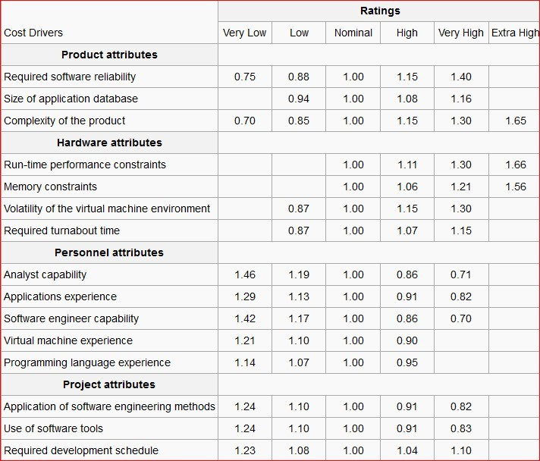

Slide 53
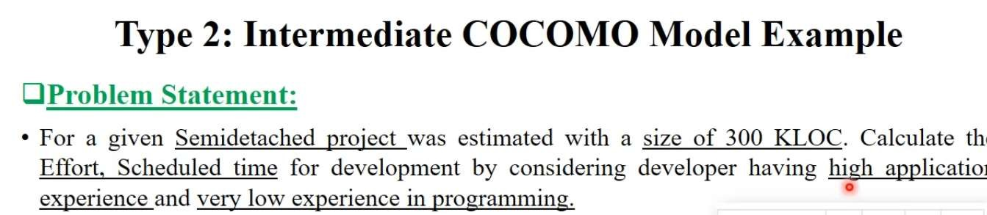

Slide 54
Complete COCOMO
It is also known as detailed COCOMO model.
□
A major shortcoming of both the basic and
intermediate COCOMO models is that they consider a software product as a single homogeneous entity.
But most large systems are made up several smaller sub-systems.
For example, some subsystems may be considered as organic type, some semidetached, and some embedded.
And these subsystems may be differ in requirements, development complexities and may not have previous experience of similar developing.

Slide 55
Complete COCOMO
Detailed COCOMO model - incorporates all characteristics of the intermediate version with an assessment of the cost driver's impact on each step (analysis, design, etc.) of the software engineering process.
It estimates the effort and development time as the sum of the estimates for the individual subsystems.
The cost of each subsystem is estimated separately.
This approach reduces the margin of error in the final estimate.
For example a distributed Management Information System (MIS) consists of different categories of the
software.

Slide 56
COCOMO Model
Advantages:
It is easy to use.
It is repeatable process.
It is versatile enough.
It works well on projects that are not so different in size , process and complexity.
It is highly standardized, based on previous experience.
It can be detailed documented.
Disadvantages:
Not accurate and not good for scientific justification.
It ignores software safety issues.
It ignores personal turnover levels.
All the levels of COCOMO are dependent on size estimates.
It also ignores many hardware issues.

Slide 57
Scheduling
It is important project planning activity.
In order to schedule the project activities, a software project manager needs to do the following:
Identify all the tasks needed to complete the project.
Break down large tasks into small activities.
Determine the dependency among different activities.
Establish the most likely estimates for the time durations necessary to complete the activities.
Allocate resources to activities.
Plan the starting and ending dates for various activities.
Determine the critical path.
58

Slide 58
Project Scheduling:GANTT Chart
It was proposed by Henry Gantt in 1914, also called time line chart.
It is mainly used to show allocation of resources to activities (Resource Planning).
The resources allocated to activities include staff, hardware, and software etc.
A Gantt chart is a special type of bar chart where each bar represents an activity. Bars are drawn along time line. Length of bar proportional to the duration of time planned.
It shows activities against time.
Slack time is also shown in the bars.
The chart is prepared by the project manager.

Slide 59
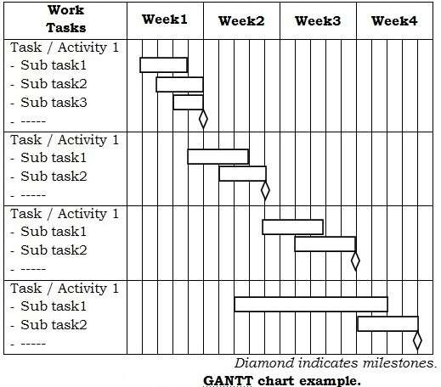
GANTT Chart
GANTT Chart example:

Slide 60
GANTT Chart
How to plan GANTT chart:
Identify all the tasks.
If possible, break down the tasks into smaller tasks.
Determine the total estimated completion time for each task.
Plot activities on GANTT chart. Draw milestones at applicable places.
On a Gantt chart you can easily see:
The start date of the project
What the project tasks are
Who is working on each task
When tasks start and finish
How long each task will take(Duration)
How tasks group together, overlap and link with each other
The finish date of the project

Slide 61
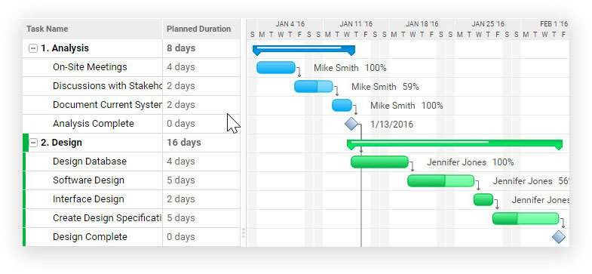
GANTT Chart
GANTT Chart example:

Slide 62

GANTT Chart
Advantages of Gantt Charts
Ჰ Clear Project Visualization
Provides a timeline-based view of tasks, making it easy to track progress.
᳀ Task Dependencies are Clear
Shows which tasks depend on others, helping teams avoid scheduling conflicts.
᲼ Improves Time Management
Helps allocate deadlines and milestones efficiently.
Შ Resource Allocation
Teams can see who is responsible for each task and balance workloads.
Ფ Easy Progress Tracking
% Completion indicators show how much work has been done.
Ჸ Enhances Communication
Stakeholders and team members get a shared view of the project status

Slide 63

Disadvantages of Gantt Charts
Ჰ Complexity for Large Projects
As projects grow, Gantt charts can become cluttered and hard to manage.
᳀ Time-Consuming to Update
Requires frequent updates to reflect real-time progress.
᲼ Doesn’t Show Detailed Task Breakdowns
Focuses more on timelines rather than deep task dependencies.
Შ Limited Adaptability in Agile Projects
Not ideal for fast-changing Agile environments
Ფ Risk of Over-Reliance
Teams may become too focused on timelines instead of quality and innovation

Slide 64
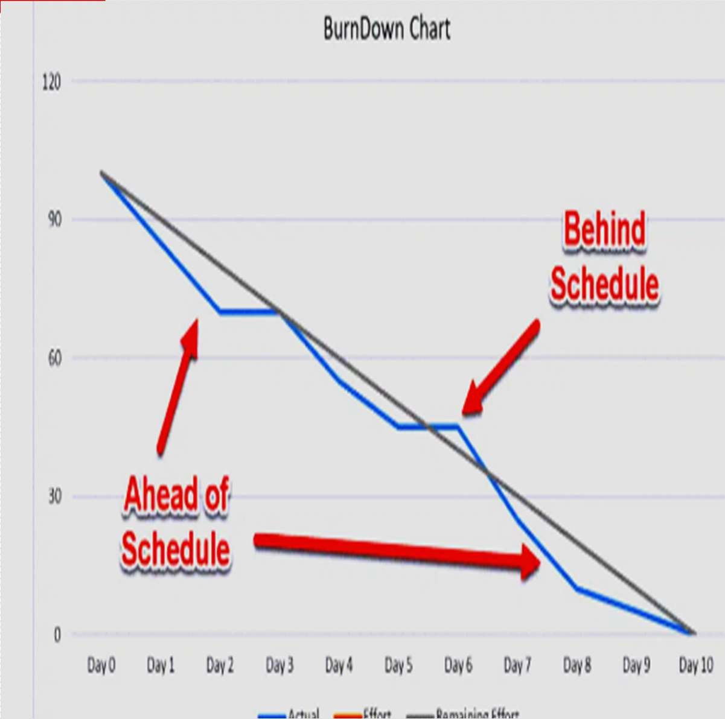
Sprint BurntDown Chart
visual representation of the remaining work versus the time required to complete it.
used to
whether enough
efficiently calculate your team has time to complete
their work and is commonly used while working in short iterations
X-Axis: Sprints or time
Y-Axis: Remaining effort
Actual effort line
Ideal effort line

Slide 65
Sprint BurntDown Chart
How to Draw:
Step 1: Estimate the effort required
For example, let’s say your ideal baseline is to complete your sprint in 5 days with 80 hours of work. That equates to 16 hours of work per day. You would then begin your effort trajectory at 80 (representing 80 hours) and track your effort for the remaining days. This would look something like this:
Day 1: 80 hours of work
Day 2: 64 hours of work
Day 3: 48 hours of work
Day 4: 32 hours of work
Day 5: 16 hours of work

Slide 66
Sprint BurntDown Chart
How to Draw:
Step 2: Track daily progress and remaining work
□
Once you have your estimates, you can begin tracking your progress. This can be done with a simple chart or timeline tool.
Step 3: Calculate actual effort spent
Step 4: Compile the final dataset
Step 5: Plot the burndown chart
daily

Slide 67
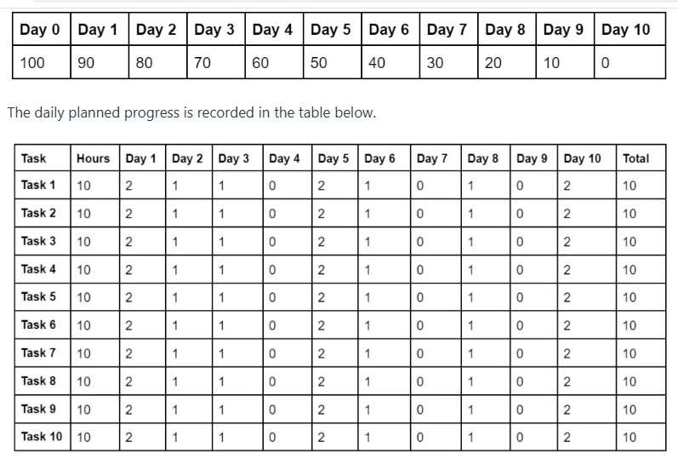
Sprint BurntDown Chart

Slide 68
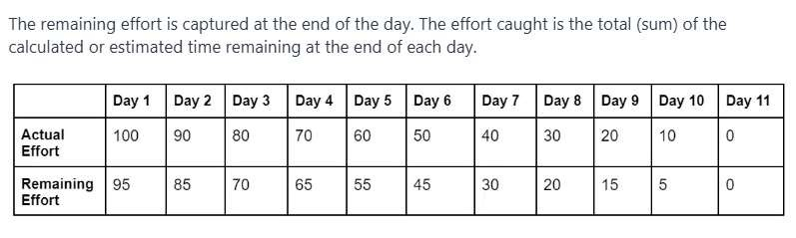
Sprint BurntDown Chart

Slide 69
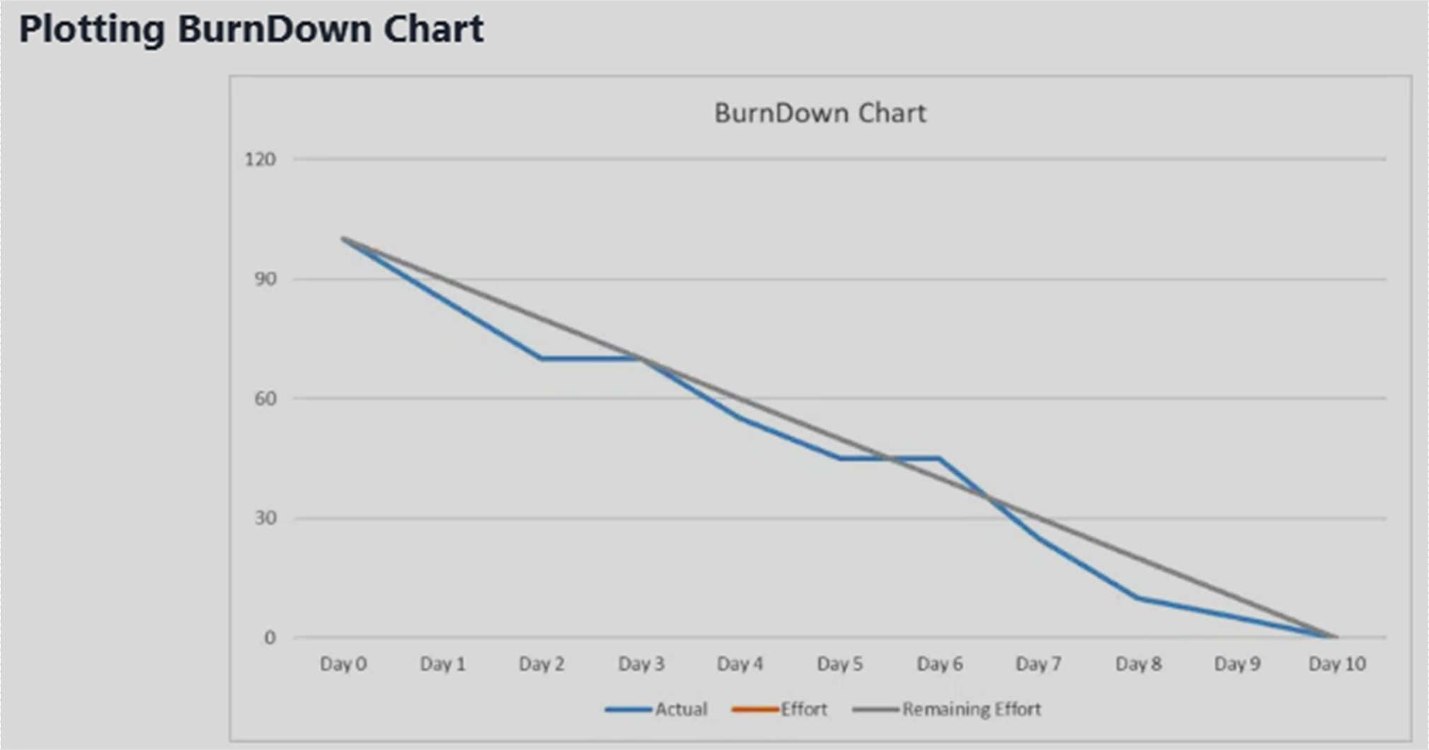
Sprint BurntDown Chart

Slide 70
Sprint BurntDown Chart:Advantages
Clear Progress Tracking – Shows how much work is completed and what remains, giving teams a clear picture of sprint status.
Motivates the Team – Seeing progress visually can boost team morale and encourage focus on completing tasks.
Helps in Sprint Planning – Provides insights into team velocity,
helping improve future sprint planning.
Encourages Transparency – Stakeholders and team members can easily understand sprint progress without needing long explanations.
Early Problem Detection – Identifies if the team is behind
schedule, allowing adjustments before the sprint ends.
Identifies Scope Creep – Any unexpected increase in work (upward trend) signals scope creep that needs to be managed.

Slide 71
Sprint BurntDown Chart:Disadvantages
Doesn’t Show Task Complexity – Only tracks work completed, not how difficult or time-consuming the remaining tasks are.
No Quality Indicator – Completing tasks quickly doesn’t mean they’re done well; technical debt isn’t visible.
Doesn’t Show Individual Contributions – It focuses on overall
team progress, not individual performance, which may be a drawback for some managers.
Potential for Misinterpretation – Stakeholders unfamiliar with Agile
might panic if they see little progress initially, even though sprints are often front-loaded with research and planning.
Can Be Misleading – A flat line early in the sprint might indicate slow progress, but work could be getting done in larger chunks later.
Can Create Unnecessary Pressure – Teams may rush to "burn
down" points rather than focusing on delivering value properly.

Slide 72
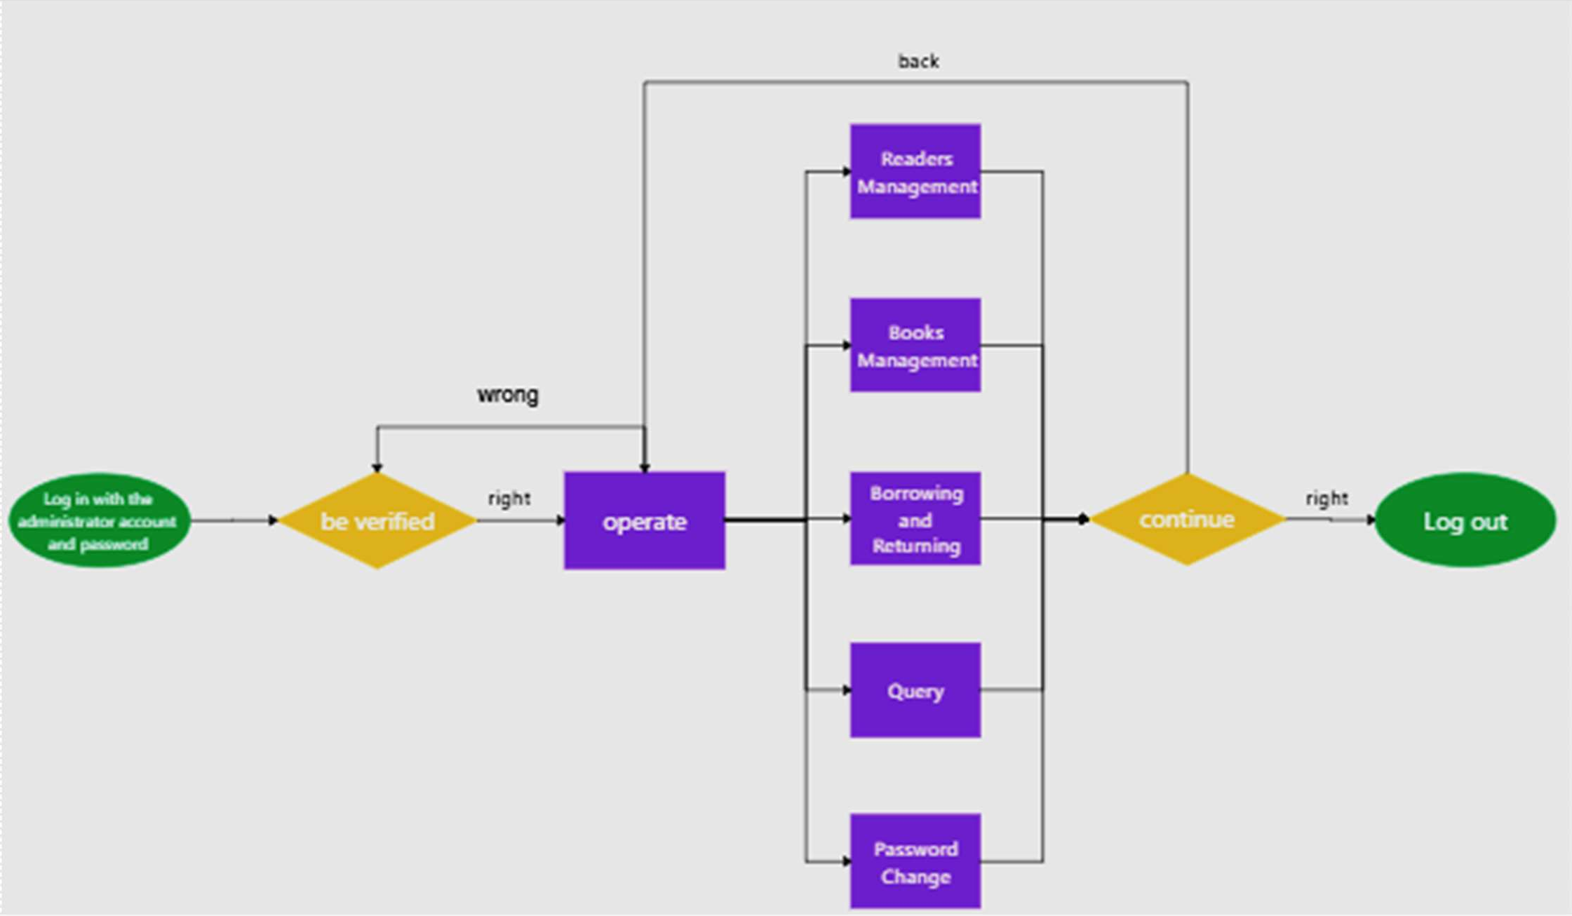
Flowchart

Slide 73
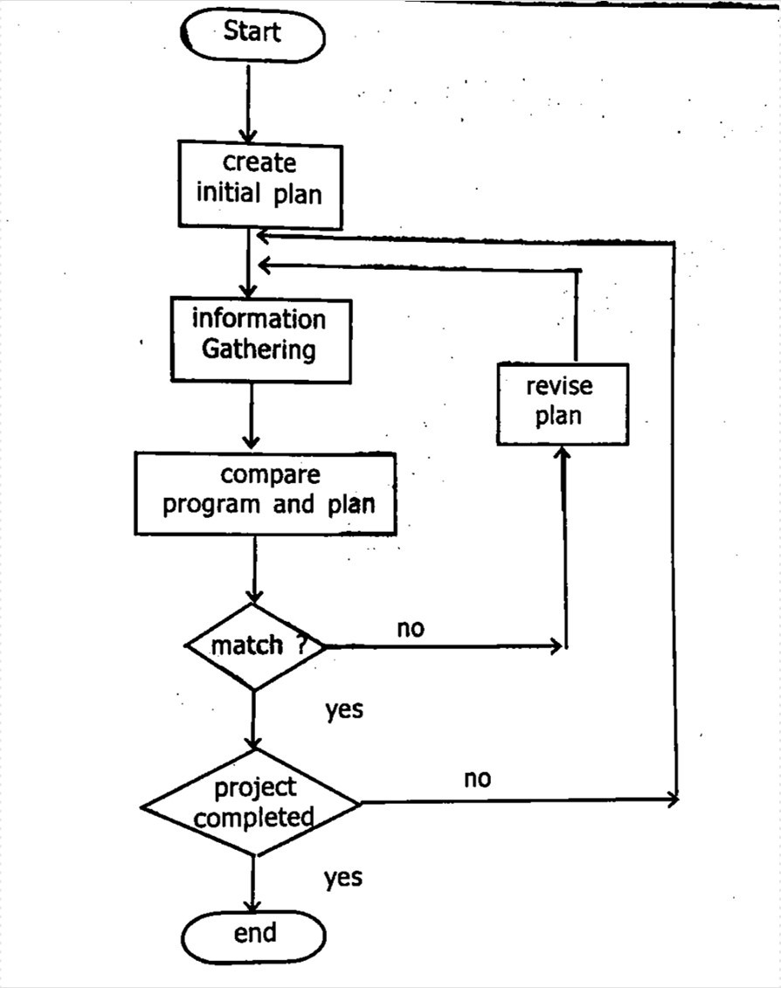

Slide 74
Flowchart:Advantages
Clear Visualization – Helps stakeholders easily understand the project flow, dependencies, and task order.
Identifies Dependencies – Shows which tasks depend on others, preventing scheduling conflicts.
Enhances Communication – Team members and managers can quickly grasp the scheduling process without reading long documents.
Aids in Problem Solving – Helps identify bottlenecks and optimize resource allocation.
Improves Efficiency – A well-structured flowchart can streamline project execution by reducing confusion.
Better Monitoring & Control – Makes it easy to track progress and adjust schedules dynamically.
Supports Automation – Can be integrated into project management tools like Gantt charts, PERT charts, and scheduling
software.
93

Slide 75
Flowchart:Disadvantages
Time-Consuming to Create – Designing a detailed flowchart takes effort, especially for large projects.
Complexity in Large Projects – As projects grow, flowcharts can become too detailed, making them difficult to read and manage.
Not Easily Modifiable – If schedules change frequently, updating a flowchart can be tedious compared to using dynamic scheduling tools like Jira or MS Project.
Limited Detail on Time & Resources – Flowcharts focus on process flow but may not effectively show exact time estimates or resource utilization.
Doesn’t show milestones– Unlike gantt Chart it does not show milestones
Does not show responsibilities
94

Slide 76
3.1 Risk Management

Slide 77
Risk Management
Today’s risk is Tomorrow’s problem.
□
Software risk is a problem that could cause some loss or threaten the success of software project, but which hasn’t
happened yet.
This risk may affect negatively to the cost, schedule, technical success or quality of the project.
Risk management is the process of identifying, addressing and eliminating these problems before they can damage the project.
Objectives of the risk management:
Identify potential problems and deal with them when they are easier to handle before they become critical.
Focus on the project’s objectives and consciously look after.
Allow early identification of risks and provide management.
Increase the chance of project success.

Slide 78
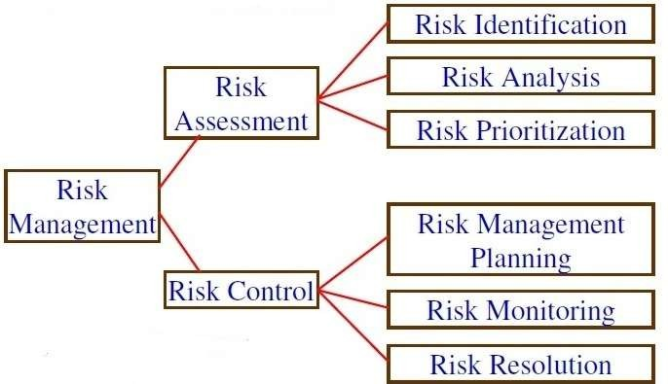
Risk Management
Risk Management Activities:

Slide 79
Risk Assessment
It is the process of examining a project and identifying areas of potential risk.
It includes the following activities:
Risk identification
Risk analysis
Risk prioritization
Risk identification
It is a systematic attempt to specify threats of the project plan.
Purpose: to develop list of risk items also called risk statement
Some common risks areas are found and checklist is prepared.
Categorize risks into different classes.
The project manager can then examine which risks from each class are relevant to the project.

Slide 80
Risk Assessment
There are three main categories of risks:
Project risks: budgetary, schedule, personnel, resource etc. Schedule slippage.
Technical risks: Risks that threaten the quality of the product. design, implementation, interfacing, testing, and maintenance problems etc. Most technical risks occur due to improper knowledge.
Business risks: Risks that threaten the development (or client) organization. Include risks of building an excellent product that no one wants, losing budgetary or personnel commitments, etc.

Slide 81
Risk Assessment
Risk analysis
When the risks have been identified, analyzed using different criteria.
all risks are
The purpose of this activity is to examine how project outcomes might change with modification of risk input variables.
The input of this activity is the list of risks developed in risk identification and output is the ranking of the risks.
Main activities of this process are:
Group similar risks
Determine risk drivers
Determine source of risks
Estimate risk exposure
Evaluate against criteria

Slide 82
Risk Assessment
Risk prioritization
It focuses on its most severe risks by assessing the risk.
Risks are estimated in probability of (0.1 – 1.0).
The higher the exposure, the more the risk should be tackled.
Another way is: risk avoidance (don’t do risky things).

Slide 83
Risk Control
It is the process of managing risks to achieve the desired outcomes.
It includes:
Risk management planning
Risk monitoring
Risk resolution
Risk management planning.
Provides plan to deal with risk.
Identify different strategies, like:
Risk avoidance
Risk minimization (risk reduction)
Risk contingency plan

Slide 84
Risk Control
Risk monitoring.
It is the continuous process of reassessing risks when project get changed.
Projects can be evaluated periodically to manage the risks.
Each key risk should be discussed at top level.
Risk resolution.
Risk resolution is the execution of the plans for dealing with each risk.
Decided by project manager.
The input of this activity is risk action plan
And out puts are:
Risk status
Acceptable risks
Reduced rework
Corrective actions
Problem prevention

Slide 85

Example:
Ჰ Risk Identification
Definition: This step involves recognizing potential risks that can affect the project’s timeline, budget, performance, or security.
Example:
A team is developing an e-commerce website. Possible risks include:
Technical Risks: The payment gateway API may not integrate properly.
Schedule Risks: Key developers may leave before project completion.
Security Risks: Customer data could be exposed to cyber threats.
Operational Risks: Server downtime may impact user experience.
Outcome: A list of risks is documented in a Risk Register for further analysis

Slide 86
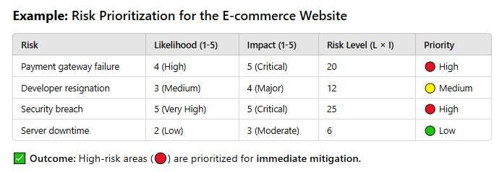
᳀ Risk Assessment
Definition: This step evaluates the identified risks based on likelihood (probability) and impact (severity) to prioritize them.
Example: Risk Prioritization for the E-commerce Website

Slide 87
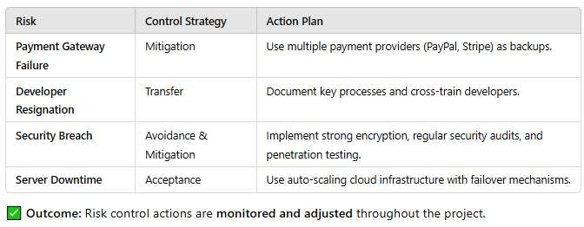
᲼ Risk Control
Definition: This step involves implementing strategies to
reduce, transfer, accept, or eliminate risks.
Example: Risk Control Strategies

